Slide 1
Low-cost hydrogen for the growing de-centralised energy market
A proven alternative fuel from validated technology
Richard Scott
Chief Commercial Officer
April 2026
Notes:
Jon – Slide 1 -6

Slide 2
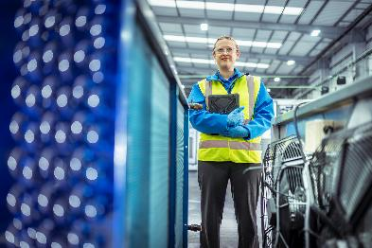
Traditional hydrogen technology has struggled to scale
Ability to access variable and intermittent power
At ~70% of the total cost
per kg the price of
electricity matters
most
Saleable co-products
Monetising co-products adds new revenue streams which subsidises the cost of producing hydrogen and unlocks routes to
market
Lower all-in system cost
Low lifetime capex
and durable systems
that are operationally
reliable
The constraint on the hydrogen market is not demand, it’s the lack of a better electrolyser to produce it
CPH2 is liberating hydrogen with breakthrough technology that solves three problems to deliver the lowest lifetime levelised cost of hydrogen at this scale.*

Slide 3
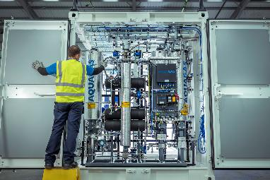
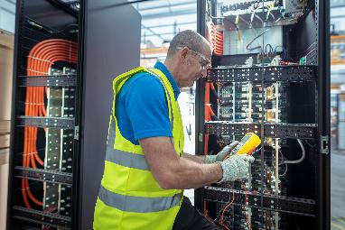



Liberating hydrogen with unique electrolyser technology
    In an unstable world, alternative energy sources are vital. When electrification is unsuitable CPH2 technology can make high purity hydrogen wherever it’s needed.
    CPH2 delivers a brand-new category of electrolysers, membrane-free for optimised, on-site, lower cost decentralised energy production.
    Traditional systems are unreliable and rely on "forever chemicals" (PFAS). Ou stack is a robust, PFAS-free and can produce ultra-pure hydrogen and above medical-grade oxygen.
    Our design eliminates fragile membranes and are modelled to deliver a 25-year asset life with lower upfront costs resulting in the lowest lifetime LCOH* available on the market at this scale.
    In 2026 we have shipped to major customers, signed with new technology partners and engaged our fourth potential licensing partner.

Slide 4
Long-term research into a cost-effective alternative to fossil-fuels led to a technology breakthrough
    Development Phase
    Demonstration Phase
    Commercial Deployment Phase
2022
2023
2024
2025
2026
2027
2027
    Listed on LSE AIM
    Licensing agreement with Fabrum
    MFE110 electrolyser passes FAT
    NI Water demo facility success
    1MW system SAT with customer & ongoing operation
    Demonstratable, repeat customer deployments
    Technology cooperation agreement with KCA Deutag
    Paul Cassidy (ex-Johnson Matthey) appointed as CTO
    1MW electrolyser sale + 2GW license agreement
    1MW system left the factory
    TRL 9 achieved
    MFE220 MKII cost validation
    Siemens cooperation agreement signed
    License partner execution
    Licensee for North America identified
    5MW FEED design
    Delivering execution milestones to reach commercial inflection with an aligned funding runway
Milestones completed
Future milestones

Slide 5




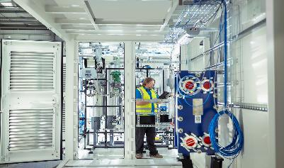
Traditional electrolysers never solved the problem
 | PEM | Alkaline | SOEC | AEM
Low Capex
Dynamic Load Following
Premium Co-products
Scalable Supply Chain
Commercial Durability
Comments | Technically elegant – economically fragile | Financeable today, but strategically limited | Strong potential but limited use cases + not widely bankable | Unproven at commercial scale | Proven at commercial scale with competitive LCOH
    Traditional electrolyser technology is based on old designs. Only marginal cost and reliability gains can be delivered.
    Incumbent technologies rely on expensive and rare minerals (iridium, platinum) and PFAS chemicals This creates high risk supply chains which are difficult to scale.
    ?
    ?
SOEC operates in a different optimisation space: high-temperature, baseload, heat-integrated industrial sites.

Slide 6




How CPH2 will unlock the hydrogen and oxygen market
Designed for operational resilience and reliability for structurally lower lifecycle cost
    Proven + IP protected
    Proven + IP protected
    Membrane-free stack
    Dryer
    Cryogen
H₂
H₂0
O
    Hydroxide ions dissolved in ordinary water to produce electrolyte
    Water in the electrolyte is consumed by CPH2’s patented electrolyser and is split into hydrogen and oxygen by electricity
    Wet mixed gases are dried to remove any water
    Oxygen and hydrogen are separated at -200°C, liquifying the oxygen and leaving pure hydrogen. Breakthrough heat-exchanger technology recovers the energy used for cooling
    High purity oxygen and hydrogen outputs as gas
    CPH2 Electrolysis Process (Watch the Video Here)
    MFE Technology
    Unique membrane-free solution, proven and delivered by CPH2 is ideally matched to curtailed or variable or intermittent low-cost renewable power
    Cryogenics Solution
    Patented heat exchanger to improve efficiency and capable of producing ultra high purity oxygen, above medical grade purity when so certified
No membrane or platinum group metals
High purity oxygen as byproduct
    Membrane free process for H2 production patented
    Compatible with variable load
    3 stream plate heat exchanger is patented
    Modular, scalable design
    Low stack degradation
High operating efficiency

Slide 7
Lowest lifetime levelised cost of hydrogen produced today
Even at the current lower scale CPH2s patented technology can beat the traditional electrolyser categories
    Competitive today Even at today’s sub-scale our all-in capital cost of $1,400 per kW results in a mid-point price of $7.08/kg LCoH¹ and as low as $4.08 which is competitive with unreliable Alkaline and beats PEM – established technologies with large-scale production
    Adding Oxygen This technology uniquely separates hydrogen and oxygen to a higher purity than other electrolyser categories. The oxygen can be sold as a by-product, accessing additional markets unavailable to our peers which brings down our LCoH to a mid-point of $5.49/kg and as low as $2.48
    Capturing the wind Because this breakthrough MFE category can follow variable loads it can capture inexpensive and sometimes free curtailed wind power. This lowers the mid-point to $5.96/kg down to $3.52
    Competitive edge By targeting the existing and growing decentralised markets that value reliability at this scale and securing medical grade oxygen off-takers, the mid-point price call fall to $4.37/kg and as low as $2.52/kg
$/kg/H2
1
2
1
2
3
3
4
4
* Low v high accounts for variation in power source and cost, running time and lifetime Opex efficiency across application types. They effect all categories equally where applicable

Slide 8
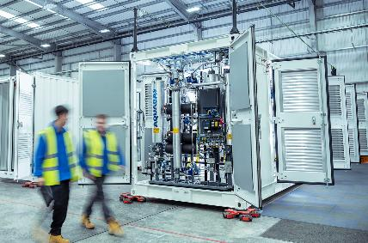


Real customers and partners have validated our cost-effective alternative fuel, and seized the oxygen upside
“We have painstakingly explored the supply chain of electrolysers; CPH2's Membrane Free technology is the standout solution”
    Hidrigin | Hydrogen EPC | Customer and Licence Partner
“We see enormous potential from the deployment of the now validated technology from CPH2 .”
    Source Energie | Irish Renewable Developer | Potential customer
“We see the CPH2 technology as a world beating, low-cost solution to the production of green hydrogen.”
Hydrogen 99.999vol%
Oxygen 99.7%
Demonstrated purity achieved with MFE110 in Northern Ireland Water site, Belfast
    Fabrum Solutions | Hydrogen Infrastructure Developer | Customer / Licensor
8
“The MFE110 electrolyser will play a crucial role in our efforts to decarbonise our operations”
    Northern Ireland Water | Irish Water Utility | Existing Customer

Slide 9
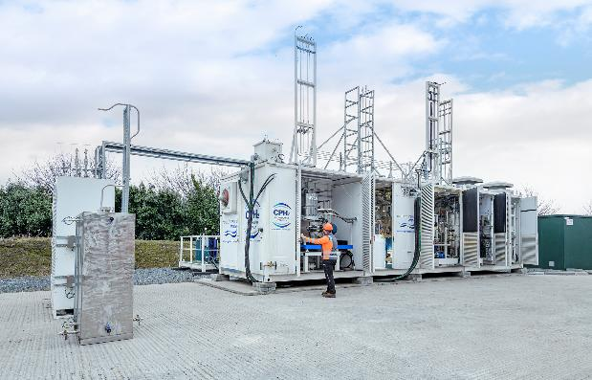






Wastewater Treatment: A Proven Success Story for CPH2
First-of-a-Kind project to Northern Ireland Water verifies our technology and USP
    Customer Problem: NIW is exploring the use of high grade O2 from electrolysis to combined with energy inefficient blowers for aeration – which account for ~50% of energy use and emissions at WWTPs.
    CPH2 Solution: Our MFE electrolyser produces high purity oxygen and hydrogen from water. The oxygen can be injected for aeration, with hydrogen providing on-site power for heat, mobility, grid services, or local offtake and sale
    Utility-scale reference: CPH2 won the competitive tender vs alternative H2 OEMs and installed at a live wastewater treatment facility. Site Acceptance Test proved successful operation in real world conditions to the designed specification.
    Follow-on demand: Following proof with the trial, NIW continued with a full 1MW unit which CPH2 will deliver to site in Q3 2026 marking TRL 9 and a full-scale commercial operating system for other customers to witness.
CPH2 MFE110 at NIW WWTP Site, Belfast

Slide 10
Our tech is optimised for the growing part of the market
Smaller behind-the-meter (BTM) projects are where the real demand for H2 and O2 exists – aligning perfectly with our technology
Distribution of Green H2 projects by size (MW)
    De-centralised focus: Our technology targets the growing project-dense part of the hydrogen market where execution, not subsidies, determines success. The majority of forecast production capacity sits in a small number of mega-projects, the majority (~80%) are decentralised and sub-20MW in size which aligns perfectly to CPH2’s MFE.
    Faster, less risky projects: Large H2 projects are slow to build, constrained by grid congestion, connection queues, and long planning / permitting processes. Focusing on the decentralised market, where our technology has proven advantages, has multiple benefits for CPH2:
    Avoid grid constraints = shorter projects timelines by several years (shorter sales cycles)
    Eliminate transport costs = £2-8/kg lower delivered H2 price (easier buying decision)
    Access curtailed energy = free, or negative, electricity (faster customer payback)
BNEF Data, 2025
All projects are FEED or beyond indicating a high degree of construction / operational certainty before 2030

Slide 11


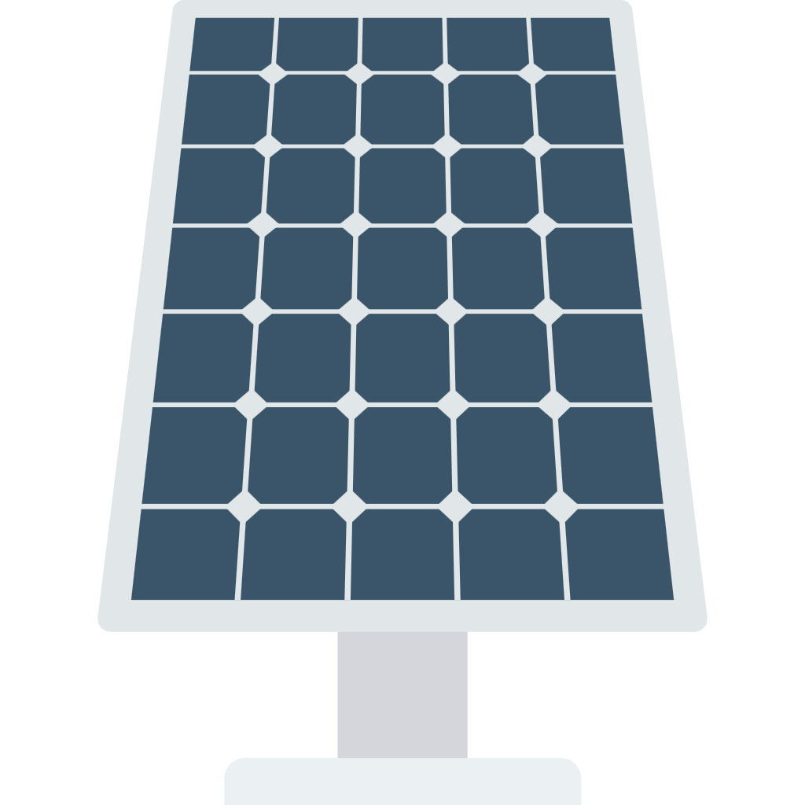
CPH2’s decentralised or Behind-the-Meter ecosystem
Our technology enables true energy security - solving existing problems faced by mission-critical industries
Oxygen
While competitors vent their low-purity oxygen, CPH2 can monetise higher purities for medical and wastewater treatment uses to subsidise the price of green hydrogen
Hydrogen
CPH2’s solution eliminates transport "tax" associated with tube-trailer delivery from centralised plants
2
3
Hospitals + Water treatment
Industry & Pharma
2
High Purity Oxygen
3
High purity green hydrogen
1
Curtailed, low-cost clean electricity
4
Clean, behind-the-meter power
Solar plant
Electrolyser
Data Centres
Curtailed clean electricity
CPH2’s electrolyser can capture curtailed (often otherwise wasted) energy to produce hydrogen and saleable oxygen, decoupling our customers from volatile commodity markets in mission critical applications
Distributed clean power
Growing demand from data centres who want behind-the-meter sources of electricity
1
4

Slide 12
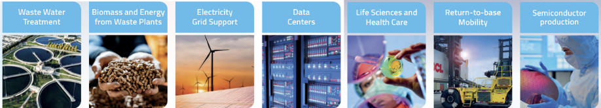
We win in the growing real-world markets
Focused market entry is how complex energy technologies reach scale - not broad market ambition
    When these conditions hold – MFE is the dominant technology…
    …creating a £2.8bn serviceable addressable market today
On-site demand for hydrogen and/or oxygen
Access to constrained, intermittent or curtailed power
Customers operating in mission-critical environments
£580m
Wastewater Treatment
    O2 demand enhances aeration processes
    Proven business case, investment saves money
    H2 for BTM power / heat and mobility
    Public utility with regulated budget
£167m
Renewables Curtailment
    H2 generated by capturing otherwise wasted wind and solar
    Solar £66m serviceable addressable market globally
    Wind £101m serviceable addressable market globally
£340m
Above Medical Grade Oxygen
    Co-locate electrolyser for medical and life sciences
    Medical grade and above O2 commands premium price
    Aggregate with H2 use-case for superior business case
£1.7bn
Data Centres
    BTM power, not reliant on the grid or diesel delivery
    Compliments short-term battery back-up with long duration, long dispatch H2 fuel-cells replacing diesel
12

Slide 13
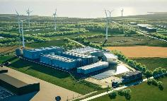
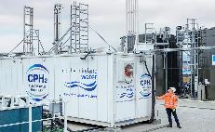
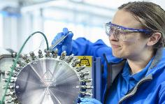
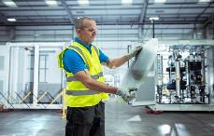
Proving deliverability at commercial scale
TRL 7
TRL 8
TRL 9
Fully commercial
Research & Development
Proven & Patented
Repeatable units deployed
    Facilitating
    Repeatable, commercial product offering
    Operating, effective global licensing solutions
    Proof of capital-light, licence led scaling model
    Gross margin improvement and self-sufficiency
    Enabling debt & asset financing solutions and lower cost of capital
    Delivering
    MFE220 SAT completion
    Extended on-site operation
    Cost-optimised MKII
    First licence partner build
    Unlocking
    Classification of MFE220 as repeatable commercial product
    Shift from technology risk to commerciality
    Delivered
    MFE110 FAT & SAT completion
    MFE110 operation achieved
    MFE220 FAT completion
    Unlocking
    Credible reference points
    Technology & Execution risk reduction
    Delivered
    Core MFE technology validation
    Established IP moat
    Successful operation of sub-MW systems
    Unlocking
    Confidence in technology concept
    Pilot deployments
TRL definitions used for illustrative commercial clarity; progression is defined by executed milestones rather than academic classification

Slide 14







Direct sale & licensing balances capital intensity for scale-up
 | Direct Sale |  | Licence Sale
Type of revenue | Upfront equipment sale | Consultancy, commissioning & ongoing services | Royalties, sale of components, upfront fee on licence agreements
Quality of revenue | Project-based one-off | High visibility once contracted | Highly predictable long-term
Capital intensity | Higher upfront capex | Potential maintenance capex | Asset-light minimal capex
Working capital requirement | High visibility requirement |  | Limited exposure
Margin profile | Higher gross margin per unit | Incremental margin | High incremental margin
Customer types | Project developers, utilities and industrial users |  | OEMs and large industrial partners
Example customers
Live negotiation

Slide 15

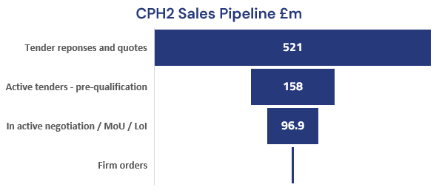
The oil shock renewed the search for cost-effective alternative fuels. In the tangible on-site market, we win
    Contracted Direct Sales
    Major utility | Northern Ireland
    1MW | 2026
    Green Hydrogen | Ireland
    1MW | 2027
    Precision Engineering | New Zealand
+159%
    2MW | 2028¹

Slide 16
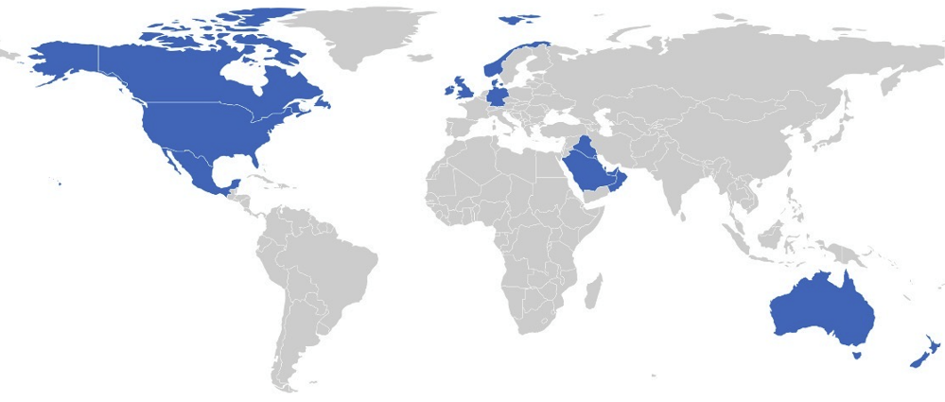
Only CPH2s strong IP can rapidly build a global network
    We have secured licensees for our unique technology in 12 countries, with the USA, Canada and Mexico now under negotiation following the signing of an MoU with a subsidiary of Koch Industries; Koch Modular Solutions.

Slide 17
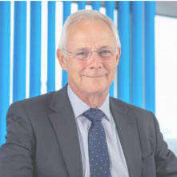
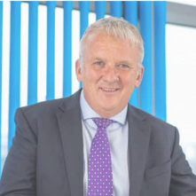
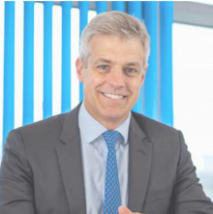
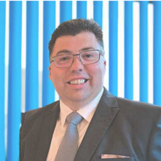
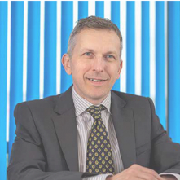











Senior management have experience in delivering
Combining deep sector expertise in technology development, scaling, and sales across the global energy and gas sectors
Chair
CEO
CFO
CCO
CTO
Chief Operations Director
Chris Train OBE
Jon Duffy
James Hobson
Richard Scott
Paul Cassidy
Asif Hussain
Proven track record of delivery working in the energy and utilities industries.
CEO, Cadent Gas Limited and National Grid Gas Distribution Limited.
Successfully led CPH2 through an IPO and listing on LSE AIM.
Performance improvement of SME’s, multi-national and FTSE 100 companies.
Direction of finance teams, acquisitions and divestments, due diligence and appraisals over multiple successful fundraises.
Expertise across AIM-listed and private energy companies.
Leading commercial strategy for CPH2 – engaging with customers and partners and delivering solutions using CPH2 technology.
Held senior roles at ACME Greentech Group in UAE, World Kinect Corporation in USA, E.ON, and GE.
Master of Engineering, University of Cambridge with Hydrogen and methanol-based technology and engineering expertise.
Manager of Methanol Technology and Hydrogenation at Johnson Matthey
International experience in chemical engineering, plant design, and commissioning. Successfully led the FAT and SAT of the MFE110.
Previously at Lenzing Group, he delivered major projects for BASF and Novartis.

